Slide 1


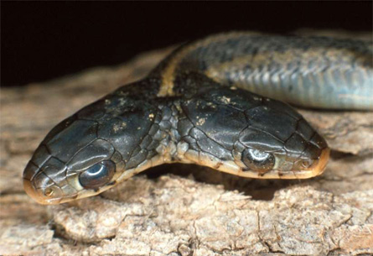
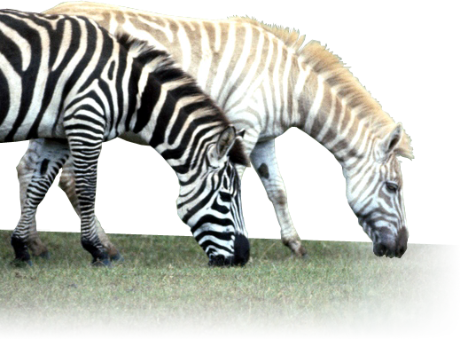

Genes & Inheritance Series: Set 2
Copyright © 2005
Version: 2.0

Slide 2
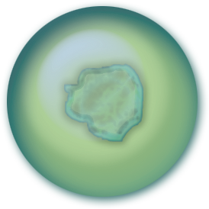

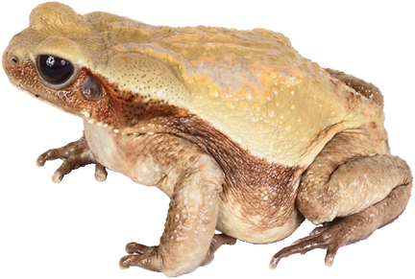
Mutations
Mutations can alter the cell’s chemistry
Chromosome
Cell
Mutation
Mutations are alterations in the DNA of chromosomes.
Many mutations may be neutral or 'silent' (i.e. they have no observable effect on the organism).
Harmful mutations become evident because they may alter the survival capacity of the organism.
Nucleus
This may cause an observable change in the organism’s:
• physiology
• anatomy
• behavior

Slide 3
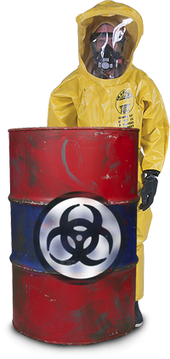
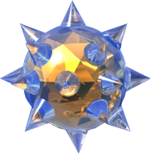


Causes of Mutations
Mutations may occur randomly and spontaneously.
They may also be induced by environmental factors.
Spontaneous mutations
  Arise from errors in replication
  Genes mutate at different rates
Induced mutations
  Mutations can be induced by mutagens
  (environmental factors that cause a change in DNA):
  Examples of mutagens:
    radiation (e.g. UV rays)
    viruses
    microorganisms
    environmental poisons and irritants
    alcohol and diet

Slide 4
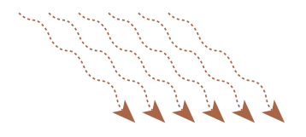


Effect of Mutagens on DNA
After exposure to UV light (a potent mutagen) adjacent thymine bases in DNA become cross-linked to form a 'thymine dimer'.
This disrupts the normal base pairing and throws the controlling gene's instructions into chaos.
UV Light
Thymine dimer
DNA of tumour suppressor gene

Slide 5

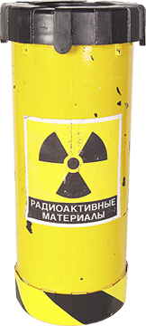
Ionizing Radiation
Mutagenic effects
  Ionizing radiation includes nuclear and ultraviolet radiation, X-rays,
  and gamma rays.
  All are potent mutagens.
  Ionizing radiation is associated with the development of cancers.
Those most at risk:
  Those working with radioisotopes.
  Those living near nuclear plants, waste dumps, or testing sites.
  Fair skinned people in tropical and sub tropical regions.

Slide 6
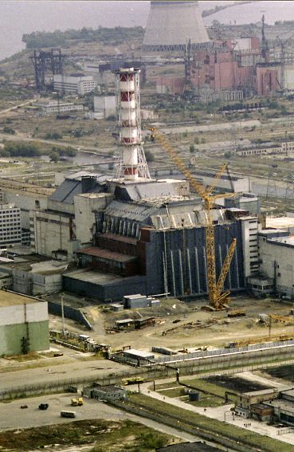

The Chornobyl Event
The most famous nuclear accident is that of Chornobyl, in the Ukraine.
  In 1986, two catastrophic explosions occurred in the number 4 reactor during routine tests.
  The explosions ejected some 8 tonnes of plutonium and other highly radioactive materials.
  This led to:
    widespread contamination of food sources
    an increase in radiation-linked diseases
    ongoing environmental problems, such as soil contamination, throughout northern parts of western Europe.
Photo Kurchatov Institute
NOTE: Chornobyl is the Ukrainian spelling
Chernobyl is the Russian spelling

Slide 7
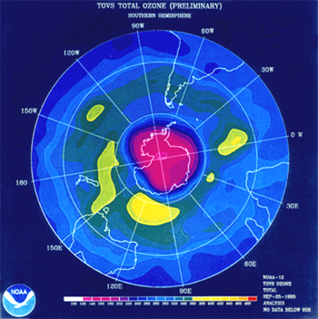

UV Rays from the Sun
The ultraviolet rays (UV-A and UV-B) from the sun are particularly damaging to the skin and the retina of the eyes.
  The development of the ozone depleted region over Antarctica each year has led to an increase in the mutagenic radiation reaching the Earth’s ecosystems.
  One of the main diseases caused by this radiation is a form of skin cancer called melanoma.
  Melanoma is an aggressive cancer that may be fatal if left untreated.
Ozone hole over Antarctica
25 September 1995 (NOAA)

Slide 8
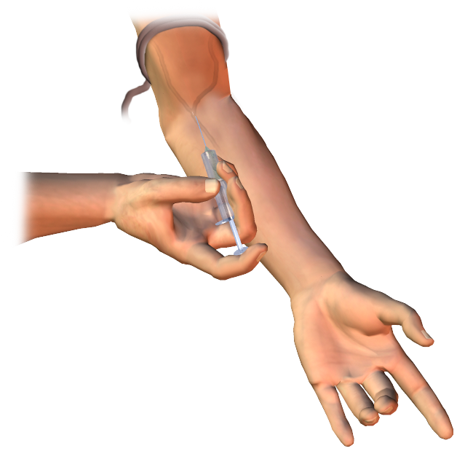
Viruses & Microorganisms
Mutagenic effects
  Some viruses integrate into the human chromosome, disrupting genes and triggering cancers.
Those most at risk:
  Intravenous drug users are at risk of hepatitis B.
  Intravenous drug users and those practising unsafe sex (i.e. unprotected sex with new partners) are at risk of HIV/AIDS.

Slide 9
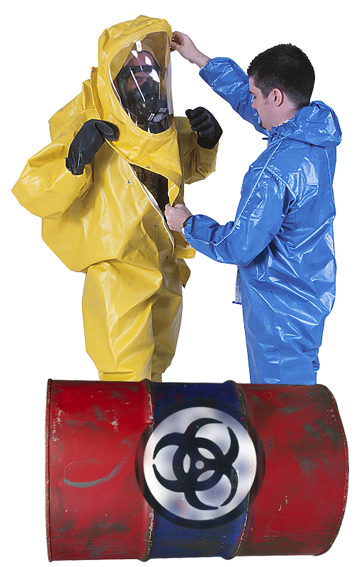
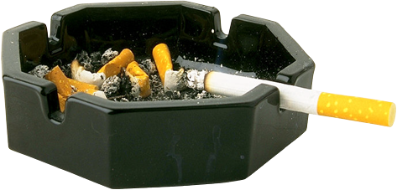
Environmental Poisons
Mutagenic effects
  Many chemicals are mutagenic.
  Synthetic and natural examples include: organic solvents (e.g. benzene), asbestos, tobacco tar, vinyl chlorides, and nitrites.
Those most at risk:
  Chemical industry workers, those in
  the glue, paint, rubber, resin, and leather industries.
  Tobacco smokers.
  Coal and other mining workers.
  Exposure to petroleum volatiles and vehicle exhaust emissions.

Slide 10

Tobacco Smoking
Mutagenic effects
  Tobacco tar is one of the most damaging constituents of tobacco smoke.
  Tobacco tars contain at least 17 known carcinogens (cancer inducing mutagens) that cause chronic irritation of the respiratory system and are a major cause of cancer in smokers.
  In recent years, there has been acknowledgement by the tobacco companies that tobacco smoke is not only addictive but also carcinogenic.

Slide 11
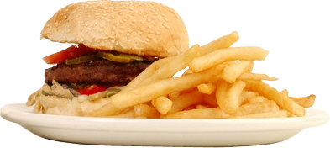

Alcohol and Diet
Mutagenic effects
  Diets high in fat slow the passage of food through the gut and give time for mutagenic irritants to form. High alcohol intake increases the risk of some cancers.
Those most at risk:
  Those with a diet high in total fats.
  Those with a familial (inherited) susceptibility.
  Those whose risks are compounded by other lifestyle choices, such as smoking.

Slide 12
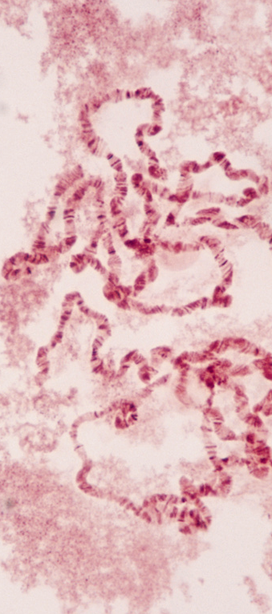
Rates of Mutation
Genes mutate at known rates. This rate varies depending on the gene involved. Some genes have high spontaneous mutation rates.
Mutant genes in the human population:
  With approximately 30 000 genes in the human genome and two copies of each gene, each cell has a total of 60 000 genes.
  In higher organisms, a mutation for a specific gene will occur in one gamete in 300 000.
  Then one in five of us on average carries about 1 new mutant gene!
6 x 10⁴ ÷ 3 x 10⁻⁵ = 0.2
Mutation rates for genes within a species are probably similar, but the viability of mutations varies greatly.

Slide 13
Human Mutation Rates
Examples of human genes with known mutation rates:
Retinoblastoma | Produces a tumor in the eye. | Dominant | 15-23
Tay-Sachs disease | Produces blindness, paralysis, and mental deficiency. Death ccurs in early childhood. | Recessive | 11
Hemophilia | Produces uncontrollable bleeding due to an inability of the blood to clot. | Sex-linked | 25-32
Muscular dystrophy | Produces progressive wasting of muscles and eventual death. | Sex-linked | 43-100
Albinism | Production of melanin affected, resulting in lack of pigment in skin, eyes, and hair. | Recessive | 28

Slide 14










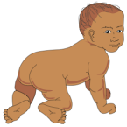
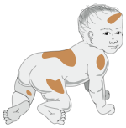
Location of Mutations
Gametic Mutations
Somatic Mutations
Mutation
Mutation
The location of a mutation determines whether or not it will be inherited.
  Most mutations occur in somatic cells and are not inherited.
  Gametic mutations occur in the cells of the gonads (which produce sperm and eggs) and may be inherited.
Sperm
Sperm
Egg
Egg
Fertilisation
Mutation
Cleavage.
Prior to implantation
Mutation
Fetus
Baby
Cells of tissues affected by the mutation
Gametic mutations are inherited and occur in the testes of males and the ovaries of females.
Somatic mutations occur in body cells. They are not inherited but may affect the person during their lifetime.

Slide 15
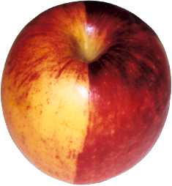
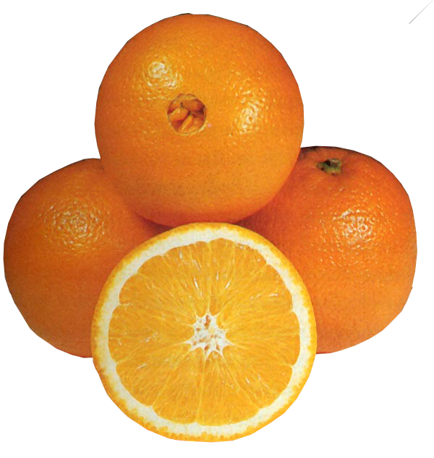
Somatic Mutations
This red delicious apple illustrates a somatic mutation.
  A mutation to the ovarian wall gives rise
  to a sector of yellow colored fruit.
  The mutation does not affect the seeds (germline) which give rise to the standard red delicious type.
  Many apple varieties, including the red delicious, arose as a result of somatic mutations. These may occur to a single branch, which can be removed and propagated vegetatively.
Navel oranges also arose as a result
of somatic mutation.
  The mutation causes a twin fruit. The smaller undeveloped twin leaves a formation at the top
  of the fruit (arrowed), which resembles a navel.
Red delicious apple
Navel oranges

Slide 16
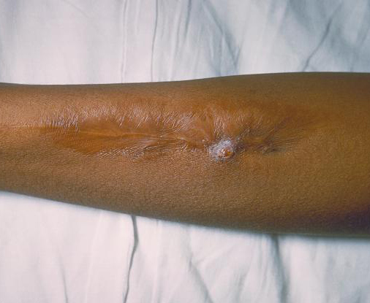
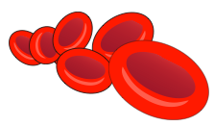


Harmful Mutations
There are many examples of harmful mutations resulting from alterations to the DNA base sequence.
  Examples in humans include:
    Sickle-cell disease
    Cystic fibrosis
    Thalassemias
  An example in animals is albinism, which increases susceptibility to predation and disease (e.g. cancers).
  These mutations are harmful because, by altering the DNA sequence, they upset the structure and function of the protein they code for.
(Photo CDC)
Sickle cell lesion
Normal red blood cells
‘Sickle-cells’

Slide 17
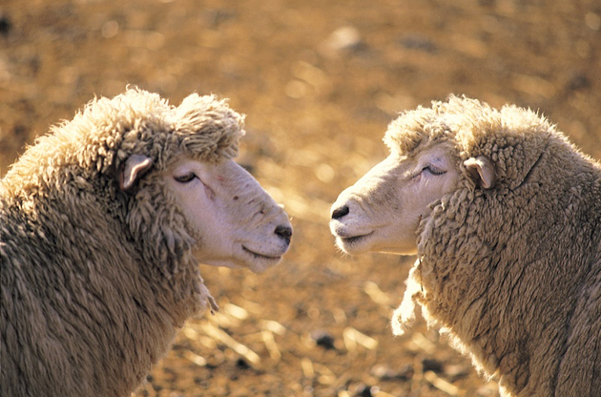
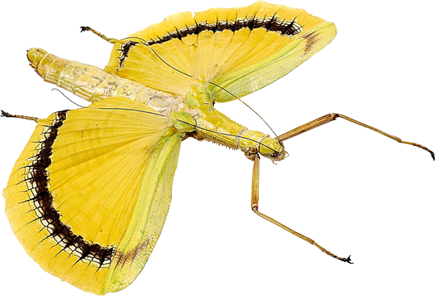
Neutral Mutations
Some mutations are neither harmful nor beneficial to the organism in which they occur. These mutations are termed neutral or silent mutations.
A mutation may have no adaptive value when it occurs, but this may
not be the case in the future.
Neutral mutations may therefore
be very important in an
evolutionary sense.
Neutral or silent mutations
have no observable phenotypic
effect, but they can be detected
using genome analysis.
The same… or are they?

Slide 18
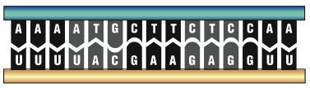

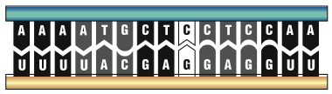
Neutral Mutations
Neutral mutations are hard to detect because they produce little or no change in the phenotype.
  They may have little or no effect on the survival of an organism or its ability to reproduce.
  They may be the result of a ‘same-sense’ mutation where a change in the third base of a codon still codes for the same amino acid.
Normal DNA
mRNA
Amino acids
Amino acid sequence from the non-mutated DNA forms a normal polypeptide chain
Mutation: Substitute C instead of T
Mutant DNA
mRNA
Amino acids
Despite the change in the last base of a triplet, the amino acid sequence is unchanged

Slide 19
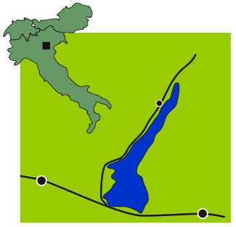

Beneficial Mutation Example
Tolerance to high cholesterol levels
in humans
  In the small village of Limone, about 40 villagers have extraordinarily high levels of blood cholesterol, with no apparent harmful effects on their coronary arteries.
  The village has a population
  of 980 inhabitants and was,
  until recently, largely isolated
  from the rest of the world, with
  sheer cliffs behind the village,
  the lake in front of them,
  and no road access.
Italy
Limone
Lake Garda
Brescia
Verona
The village of Limone, on the shore of Lake Garda, Italy

Slide 20
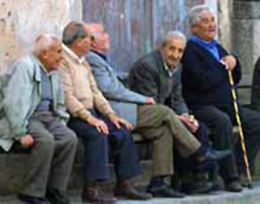
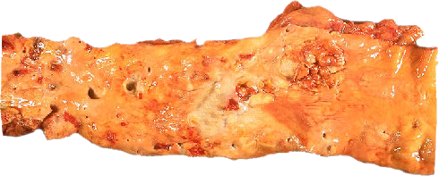
Beneficial Mutation Example
The 40 villagers possess a point mutation which alters the protein produced by just one amino acid. This protein is ten times more effective at mopping up excess cholesterol.
  No matter how much excess cholesterol is ingested, it can always be disposed of.
  All carriers of the mutation are related and have descended from one couple who arrived in Limone in 1636.
  Generally, the people of Limone
  live longer and show a high
  resistance to heart disease.
High blood cholesterol and dietary fat are implicated in the formation of plaques in the coronary arteries and in the development of cardiovascular disease.

Slide 21
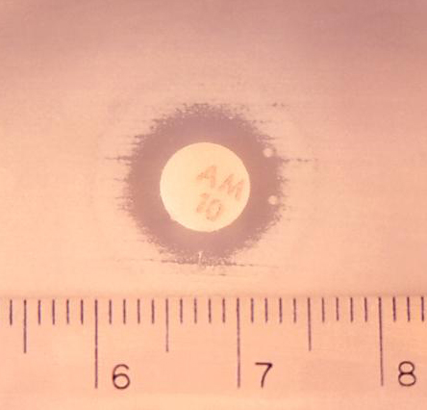
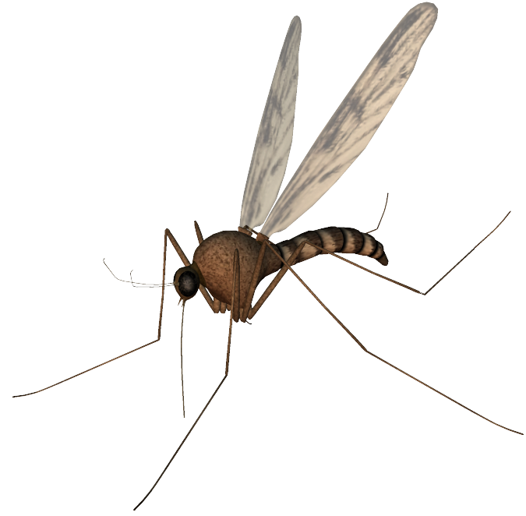
Beneficial Mutations
Ampicillin resistant E.coli
Beneficial mutations are best observed in species with short generation times.
Examples of beneficial mutations include:
  Bacterial resistance to antibiotics.
  Insecticide (e.g. DDT) resistance in insect pests.
  Changes to the make-up of the protein coats of viruses.
Photo CDC
Changes to the protein coat enable viruses to keep ahead of the mammalian host’s immune response.
DDT resistant mosquito

Slide 22
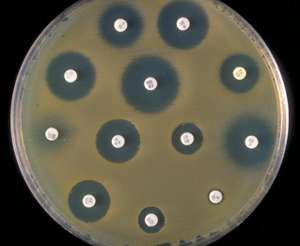
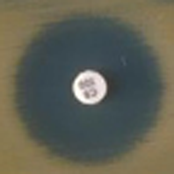
Antibiotic Resistance
Antibiotics are drugs that inhibit bacterial growth.
  With increased antibiotic use after WWII, bacteria quickly developed resistance.
  A survey in five European countries showed that around 40% of hospital samples contained at least one antibiotic resistant strain.
  Resistant bacteria include: Klebsiella, Enterococcus, E. coli, Staphylococcus aureus, Enterobacter, Pseudomonas, and Mycobacterium tuberculosis.
Agar plate (nutrient growth medium) with bacterial colonies spread uniformly across its surface.
Colonies of bacteria are distributed evenly across the agar plate surface.
Zone of inhibition where there is little or no bacterial growth.
Petri dish
Paper disc saturated with antibiotic.
Bacteria resistant to this antibiotic
Photo CDC

Slide 23
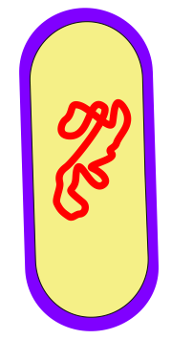
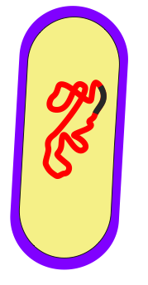

Origin of Antibiotic Resistance
Antibiotic resistance may be acquired spontaneously due to a mutation in the bacterial DNA.
Spontaneous mutations may be caused by:
  transcription error
  radiation
  chemicals
Mutated gene codes for antibiotic resistance.

Slide 24
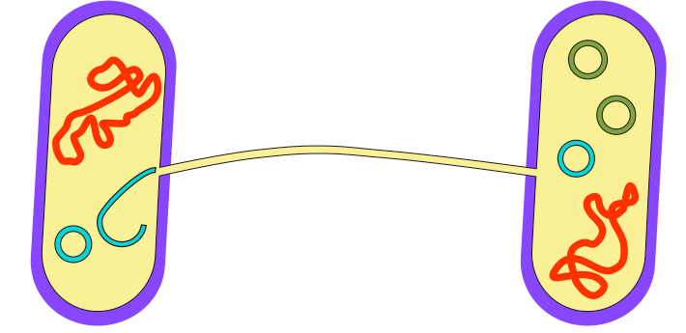
Acquiring Resistance
Bacteria can acquire antibiotic resistance by conjugation.
  A plasmid containing antibiotic resistance is transferred via a sex pilus between the bacteria during the process of conjugation.
  These bacteria may be the same or different species.
Plasmid gives resistance to antibiotic 2.
Sex pilus between the bacteria
Plasmid giving resistance to antibiotic 1.
This bacterium transfers a plasmid carrying resistance to antibiotic 1.
This bacterium contains plasmids which give resistance to both antibiotics 1 and 2.

Slide 25
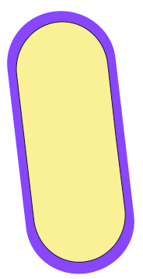
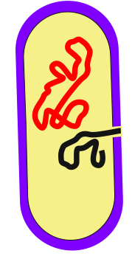

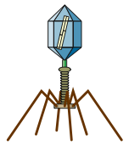

Acquiring Resistance
Antibiotic resistance can be spread between bacteria by transduction.
  Bacterial DNA, carried by a viral vector, integrates into the
  bacterial cell’s genome, providing antibiotic resistance.
A virus, which has acquired a gene for antibiotic resistance from one bacterium, transfers it to another bacterium.
Bacterium acquires the antibiotic resistant gene

Slide 26
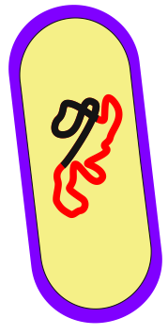
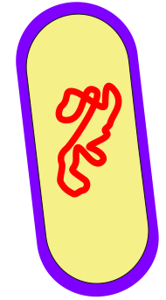

Acquiring Resistance
The spread of antibiotic resistance between bacteria can occur through transformation.
  Naked DNA containing a gene for antibiotic
  resistance is engulfed by the bacterium.
The naked DNA is taken in and integrated into the bacterial genome, providing antibiotic resistance.
Naked DNA containing a gene for antibiotic resistance

Slide 27

Mechanism of Resistance
Genes for antibiotic resistance may confer different properties.
A new gene may code for an ability to inactivate the antibiotic.
  A mutated enzyme produced in the bacterium destroys the antibiotic.
  Many bacteria that are resistant to penicillin possess such an enzyme (called penicillinase).
  Penicillinase inactivates penicillin by catalyzing the destruction of bonds within the penicillin molecule, thereby inactivating it.
Penicillin molecule
Inactive penicillin molecule

Slide 28
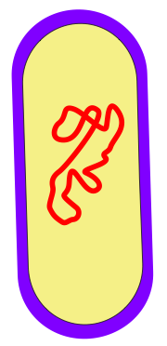
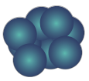
Mechanism of Resistance
A mutant gene may code for an ability to alter the target of the antibiotic.
  Some antibiotics (e.g. streptomycin) inhibit bacterial protein synthesis.
  However, if only one amino acid in either of two positions on a ribosome is replaced, a bacterium can develop streptomycin resistance.
  Some antibiotics, such as penicillin, interfere with cell wall synthesis. Therefore, mutations to the cell wall proteins can result in resistance.
Altered bacterial ribosome circumvents the action of the antibiotic
Cell wall prevents entry of antibiotic

Slide 29
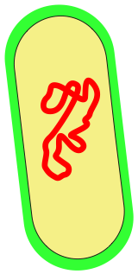
Mechanism of Resistance
In order to be effective, antibiotics
have to get into the bacterial cell and interfere with its cellular processes.
Antibiotic resistance can be achieved by altering the permeability of the bacterial cell to the antibiotic.
  Resistance can be acquired by excluding the antibiotic or by slowing its entry enough to render the antibiotic ineffective.
  Bacteria can develop proteins that actively pump antibiotics out of their cell faster than the antibiotics can enter.
Bacteria exclude or slow down entry of antibiotic
Bacteria actively pumps the antibiotic out of the cell

Slide 30



Types of Mutation 1
Gene mutations
  Genetic change affecting the base sequence of a single gene.
  Gene mutations may result in the formation of a new allele.
Mutation: Substitute T instead of C
Original
DNA
Mutant DNA

Slide 31



Types of Mutation 2
Chromosome mutations (also called block mutations)
  Changes in the structure of a chromosome
  involving large pieces being rearranged.
  Whole groups of genes are affected.
Chromosome segment is lost
Break
Break
Genes

Slide 32
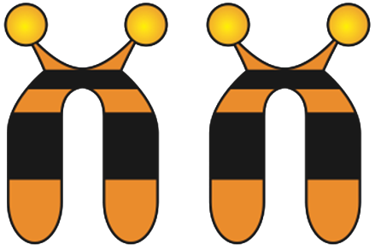


Types of Mutation 3
Changes in chromosome number
  Aneuploidy: The loss or gain of whole chromosomes.
  Polyploidy: The loss or gain of complete sets of chromosomes.
The example above illustrates trisomy 21, a condition that is responsible for Down syndrome

Slide 33

Point Mutations 1
Gene mutations change the sequence of bases in DNA for a single gene. They may produce a new allele of a gene.
  Gene mutations involving a single nucleotide are usually called point mutations.
  The new DNA sequence may result in a new sequence of the amino acids constituting a protein.
  Because of the degeneracy in the genetic code, not all changes in a DNA sequence will result in a new sequence of amino acids.
  Even with a change in amino acid sequence, protein function may be unaffected (the mutation is neutral).
Mutant DNA

Slide 34



Point Mutations 2
As a reference for the following screens, the diagram below illustrates the transcription and translation of DNA without a point mutation.
Original Unaltered Code
Original DNA
Transcription
mRNA
Translation
Amino acids
Amino acid sequence forms a normal polypeptide chain

Slide 35




Missense Substitution
A single base is substituted by another.
  Usually results in coding for a new amino acid in the polypeptide chain.
  If the third base in a triplet had been substituted, the resulting amino acid may not be altered (due to degeneracy in the code).
Mutation: Substitute T instead of C
Original DNA
Mutant DNA
mRNA
Amino acids
Polypeptide chain with wrong amino acid

Slide 36





Nonsense Substitution
A single base is substituted by another.
  This results in a new triplet that does not code for an amino acid.
  The resulting triplet may be an instruction to terminate the synthesis of the polypeptide chain.
Mutation: Substitute A instead of C
Original DNA
Mutant DNA
mRNA
Amino acids
Mutated DNA creates a STOP codon which prematurely ends synthesis of the polypeptide chain

Slide 37






Reading Frame Shift by Insertion
A single base is inserted, upsetting the reading sequence for all those after it.
  A reading frame shift results in new amino acids in the polypeptide chain from the point of insertion onwards.
  The resulting protein will be grossly different from the one originally encoded (it is most likely to be non-functional).
Mutation: Insertion of C
Original DNA
Mutant DNA
mRNA
Large scale frame shift results in a new amino acid sequence. The resulting protein is unlikely to have any biological activity.
Amino acids

Slide 38





Partial Reading Frame Shift
A single base is inserted and another is deleted at a different location. This causes a localised frame shift.
  The amino acid sequence between these points changes.
  Depending on how many amino acids are affected, the resulting protein may have some biological activity.
Mutation: Insertion of C
Mutation: Deletion of C
Original DNA
Mutant DNA
mRNA
Altered chain which may or may not produce a protein with biological activity
Amino acids

Slide 39








Tautomerism
Usual base combinations
Abnormal base combinations
Some point mutations may result from bases with an unusual number of hydrogen-bonding sites.
Irregular base configurations are called tautomers and are indicated by abnormal base combinations. They arise spontaneously and exist alongside normal base configurations.
Tautomerism may result in mismatching of base pairs.
Normal
base
Normal partner
Abnormal
base
Abnormal partner
Cytosine
Guanine
Abnormal
Cytosine
Adenine
Thymine
Adenine
Abnormal
Thymine
Guanine
Adenine
Thymine
Abnormal
Adenine
Cytosine
Hydrogen bonds
Guanine
Cytosine
Abnormal
Guanine
Thymine

Slide 40

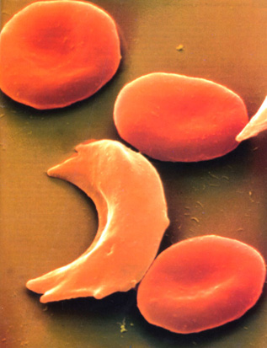
Sickle Cell Disease
Gene location: Chromosome 11
HBB
Synonym: Sickle cell anemia
Incidence: Most common in people of African ancestry.
  West Africans: 1%
  (10-45% are carriers)
  West Indians: 0.5%
  Gene type: Autosomal recessive mutation (HBB) on chromosome 11 which results in the substitution of a single nucleotide in the HBB gene coding for the beta chain of hemoglobin.
p
q
Normal red blood cells
Sickle-cell
Photo Defiers.com

Slide 41
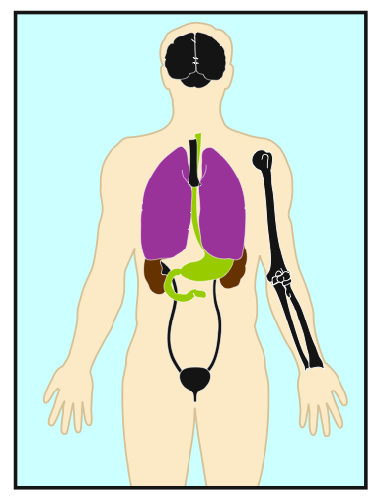
Sickle Cell Disease
Symptoms include the following:
  Pain, ranging from mild to severe, in the chest, joints, back, or abdomen
  Swollen hands and feet
  Jaundice
  Repeated infections, particularly pneumonia and meningitis
  Kidney failure
  Gallstones (at an early age)
  Strokes (at an early age)
  Anemia.

Slide 42
Sickle Cell Disease
Treatment and outlook:
  Patients are given folic acid.
  Acute episodes may require:
    oxygen therapy
    intravenous infusions of fluid
    antibiotics to treat infection
  Experimental therapies include bone marrow transplants and gene therapy.
(Photo CDC)
Sickle cell lesion

Slide 43
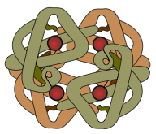
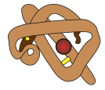

Sickle Cell Mutation
The mutation responsible for causing sickle cell disease is a point substitution mutation.
Hemoglobin molecules
are made up of 2 α-chains and 2 β-chains linked together
Normal Red Blood Cells
containing normal hemoglobin (soluble)
Sickle Cells
containing mutant hemoglobin (less soluble)
Beta (β) chain
Alpha (α) chain
Hemoglobin clusters together to form fiber, which deform the red blood cells into a sickle shape
β-Chain
hemoglobin
First base
Normal base: T
Substituted base: A
The sickle cell mutation involves the substitution of one base for another in the HBB gene, causing a single amino acid to be altered.
DNA
Codes for the 1st amino acid

Slide 44

Cystic Fibrosis
Synonyms: Mucoviscidosis, CF
Incidence: Varies with populations:
  Asians: 1 in 10 000
  Caucasians: 1 in 20-28 are carriers
Mutation type: Autosomal recessive. Over 500 different recessive mutations of the CFTR gene have been identified:
  deletions, missense, nonsense, terminator codon
p
q
CFTR
Gene location
Chromosome 7

Slide 45
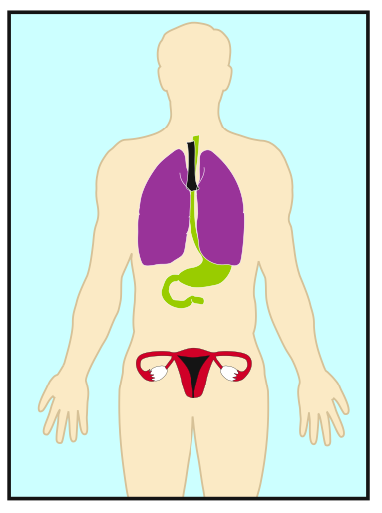
Cystic Fibrosis
Symptoms:
  Infertility occurs in males and females.
  Disruption of the following glands:
    the pancreas
    intestinal glands
    biliary tree (biliary cirrhosis)
    bronchial glands (chronic lung infections)
    sweat glands (high salt content of which becomes depleted in hot environments)

Slide 46
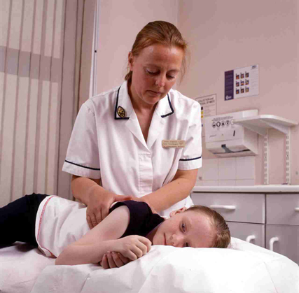
Cystic Fibrosis
Conventional treatment:
  Chest physiotherapy
  A modified diet
  Supplementary pancreatic enzymes
  The use of antibiotics including TOBI (Tobramycin solution for Inhalation) to control lung infections.
Outlook:
  Gene therapy inserting normal CFTR gene using adenoviral vectors and liposomes.
(Photo: UK Cystic Fibrosis Gene Therapy Consortium)
A child with cystic fibrosis undergoing chest massage in order to expel mucus

Slide 47



Cystic Fibrosis Mutation
The mutation causing 70% of cystic fibrosis cases is a gene mutation (delta F508) involving a triplet deletion.
Base 1630
CFTR protein
Part of the DNA sequence in the CFTR gene
This triplet codes for the 500th amino acid
The 508th triplet is absent in the mutant form
Cl-
Cl-
Cl-
Water
Cl-
Outside
the cell
Outside
the cell
Cell
membrane
Cell
cytoplasm
Cell
cytoplasm
Cl-
Cl-
Cl-
Cl-
Cl-
Cl-
Cl-
Normal CFTR protein
regulates chloride transport across the membrane
Mutant CFTR protein
cannot regulate chloride transport. Chloride ions to remain in the cell and water enters the cell

Slide 48

beta-Thalassemia
Synonyms: Cooley’s anemia, Mediterranean anemia
Incidence: The most common type of thalassemia affecting 1% of some populations.
  More common in Asia, the Middle East and the Mediterranean.
Mutation type: An autosomal recessive mutation of the HBB gene coding for the hemoglobin beta chain.
It may arise through a gene deletion or a nucleotide deletion or insertion.
HBB
p
q
Gene location
Chromosome 11

Slide 49

beta-Thalassemia
Symptoms:
  The result of hemoglobin with few or no beta chains, causes a severe anemia during the first few years of life.
  People with this condition are tired and pale because not enough oxygen reaches the cells.
Conventional Treatment:
  Patients require frequent blood transfusions. This leads to iron build-up in their heart, liver, and other organs.
Outlook:
  Bone marrow transplants and gene therapy hold promise and are probable future treatments.

Slide 50

Huntington Disease
Synonym: Huntington’s chorea, HD (abbreviated)
Incidence: An uncommon genetic disease present in 1 in 20 000 people.
Mutation type: An autosomal dominant mutation of the HD gene (IT15) caused by an increase in the length (36-125) of a CAG repeat region (normal range is 11-30 repeats).
p
IT15
q
Gene location Chromosome 4

Slide 51


Huntington Disease
Symptoms
  Mutant gene forms defective protein, Huntingtin.
  Progressive, selective nerve cell death associated with chorea (jerky, involuntary movements)
  Psychiatric disorders
  Dementia
    memory loss
    disorientation
    impaired ability to reason
    personality changes

Slide 52


Huntington Disease
Treatment:
  Previously little treatment possible. Recent trials of gene therapy appear promising.
Outlook:
  Surgical treatment may be possible.
  Development of drugs that interfere with Huntingtin protein.
  Genetic counselling coupled with genetic screening of embryos may be developed in the future.

Slide 53

Causes of Block Mutations
Some block (chromosome) mutations occur as a result of errors in crossing over during meiosis.
Mutagens also cause block mutations.
Block mutations cause genetic imbalances which usually disrupt development. They can be described as:
  Inversion: Pieces of chromosome are flipped so the genes appear in reverse order.
  Translocation: Pieces of chromosome are moved from one chromosome into another.
  Duplication: Pieces of chromosome are repeated so there are duplicate segments.
  Deletion: Pieces of chromosome are lost.
Photo Cytogenetics Dept. Waikato Hospital

Slide 54





Block Mutations: Deletion
Chromosome
rejoins
Break occurs at two points on the chromosome and the middle piece falls out.
The two ends rejoin to form a chromosome deficient in some genes.
Alternatively, the end of a chromosome may break off and be lost.
Break
Segment
is lost
Break
Genes
Step 1
Step 2
Step 3

Slide 55




Deletion Example
Human chromosome 1 shows two forms of deletion.
  These may involve deletion of either a chromosome tip (left) or a middle segment with the tip rejoined (right).
Deletions involving small amounts of chromosomal material underlie several disorders, including:
  Cri-du-chat syndrome
  Prader-Willi syndrome
  Angelman’s syndrome
Deletions of large amounts of chromosomal material are
usually lethal.
Tip deletion
Mid-segment deletion
Before
After
Before
After
Tip
rejoins
1
1
Lost
Lost
1
1

Slide 56





Block Mutations:
Translocation
Translocation involves the movement of a group of genes between different chromosomes.
A piece of one chromosome breaks off
and joins on to another chromosome.
The result is a chromosome deficient in genes and one with too many genes.
Segment
removed
Segments
join
Break
Genes
Step 1
Step 2
Step 3

Slide 57




Translocation Example
Before translocation
After translocation
Translocation can occur between human chromosomes 9 and 22.
The tips of the two chromosomes are exchanged.
This is the translocation observed in chronic myeloid leukemia.
22
22
9
The tips of the chromosomes swap
9

Slide 58


Block Mutations: Inversion
The middle piece of the chromosome falls out, rotates through 180°, and then rejoins.
There is no loss of genetic material.
Break
Segment
rejoins
Break
Segment
rotates 180°
Genes
Step 1
Step 2
Step 3

Slide 59


Inversion Example
A segment of human chromosome 2 is inverted (caused by looping of the chromosome)
All inversions cause abnormalities during meiosis and affect the viability of the gametes produced.
However, if a combination of genes within an inversion is desirable, they can act as a supergene and can confer a selective advantage.
Normal
Inversion
Flip
2
2

Slide 60






Block Mutations: Duplication
A segment is lost from one chromosome and is added to its homologue.
  The chromosome on the left was the 'donor' of the duplicated piece of chromosome.
  The chromosome with the duplication will become incorporated into a gamete, which may later contribute to an embryo.
Segment
removed
Joins on to
homologous
chromosome
Break
Genes
Step 1
Step 2
Step 3

Slide 61


Duplication Example
A segment of human chromosome 9 is duplicated.
  A segment is taken from its homologue and inserted to produce double copies of some genes.
  Some genes may be disrupted.
Gene duplications can have evolutionary significance.
  Example: The alpha and beta chains of hemoglobin arose following a duplication event 500 million years ago.
Normal
Duplication
Duplicate
segment
A segment is tansferred from one chromosome into its homologue
Identical
segment
9
9

Slide 62



Photographic Examples
What types of chromosomal rearrangement is represented in each of the following photos of human chromosomes:
  Choose from: deletion, translocation, inversion, duplication
missing
Photos: Cytogenetics Dept. Waikato Hospital
1
10
15
14
21
Translocation
Deletion
Translocation

Slide 63

Aneuploidy
The normal condition for a body cell is for chromosomes to be present as homologous pairs (a condition known as disomy).
Aneuploidy is a condition where one or more chromosomes are missing from or added to the normal somatic cell chromosome number.
  Examples:
  Nullisomy 0 homologues
  Monosomy 1 homologue
  Trisomy 3 homologues
  Tetrasomy 4 homologues
Aneuploidies usually result from
non-disjunction during meiosis.
A technician checking human fetal cells for anueploidy

Slide 64



Non-disjunction in Meiosis
The meiotic spindle normally distributes chromosomes to daughter cells without error. However, mistakes can occur during meiosis in which the chromosomes, or sister chromatids, fail to separate properly at anaphase.
  This mishap is called non-disjunction. It can occur during meiosis I or meiosis II.
  Non-disjunction results in abnormal numbers of chromosomes passing to the gametes.
  If either of these aberrant gametes unites with a normal one at fertilization, the offspring will have an abnormal chromosome number.
  This is known as an aneuploidy, e.g. trisomies.
Photos: Cytogenetics Dept. Waikato Hospital
Trisomy 13
Trisomy 18
Trisomy 21

Slide 65



Non-Disjunction: Meiosis I
Non-disjunction
Meiosis I
A non-disjunction in meiosis I occurs when homologous chromosomes fail to separate properly during anaphase I.
  One gamete receives two of the same sort of chromosome and the other gamete receives no copy.
Meiosis II
Gametes
n+1
n+1
n–1
n–1

Slide 66



Non-Disjunction: Meiosis II
Meiosis I
A non-disjunction in meiosis II occurs when sister chromatids fail to separate properly during anaphase II.
  One gamete receives two of the same sort of chromosome and the other gamete receives no copy.
  Some gametes are unaffected.
Meiosis II
Non-disjunction
Gametes
n+1
n–1
n
n

Slide 67

Aneuploidy
Aneuploidy may involve autosomes:
  Down syndrome: Chromosome 21
  Edward syndrome: Chromosome 18
  Patau syndrome: Chromosome 13
May involve sex chromosomes:
  Klinefelter syndrome: XXY
  Turner syndrome: XO
Why are they called syndromes?
  When a disease causes multiple effects it is called a syndrome.
  Virtually all chromosome abnormalities are in this category.
(Photo CDC)
Newborn with Down syndrome

Slide 68

Down Syndrome
Chromosome disorder: Trisomy 21
Incidence rate of 1 in 800 births in women giving birth at 30 to 31 years of age.
  This is the most common form of aneuploidy in human newborns that remain viable at birth.
The young boy (right) shows the typical appearance of Down syndrome.

Slide 69


Causes of Down Syndrome
There are three causes of Down syndrome, each producing a different severity of the syndrome.
  95% of all cases result from non-disjunction of chromosome 21 during meiosis (see the karyotype right).
  3-4% result from translocation of chromosome 21 (usually on to chromosome 14).
  1-2% arise from a failure during mitosis (non-disjunction of chromosome 21) in a cell of a very early embryo. The resulting individual is a ‘mosaic’ of normal and Down syndrome cells.
Photo: Cytogenetics Dept. Waikato Hospital

Slide 70





Down Syndrome Phenotype
The expression of traits in the Down syndrome phenotype varies greatly, depending on the chromosomal cause.
The most common
phenotypic traits are:
  Skin fold over the eye.
  Reduced mental
  capacity (varies greatly).
  Short stature, stubby
  fingers, and heart defects.
Small and arched palate, large wrinkled tongue, dental anomalies
Slanting eyes
Epicanthic eyefold
Short, broad hands
Broad flat face, short nose, flat back of head
Absence of one rib on one or both sides
Congenital heart disease
Abnormal ears
Intestinal blockage
Special skin ridge patterns. Many “loops” on fingertips. palm creases.
Enlarged colon
Umbilical hernia
Big toes widely spaced
Abnormal pelvis
Poor muscle tone

Slide 71


Edward Syndrome
Chromosome disorder: Trisomy 18
  The next most common trisomy
  after Down syndrome but much
  more severe.
  Incidence rate of 1 in
  6 000 live births (with a
  weak maternal age effect).
  Females are affected more
  than males (ratio of 1:2 of
  males: females)
  Commonly a result of
  non-disjunction in meiosis
  I or II or, more rarely
  translocation. Mosaicism
  also occurs.
Photo: Cytogenetics Dept. Waikato Hospital

Slide 72



Edward Syndrome Phenotype
Phenotype of an Edward syndrome child:
  Ear deformities.
  Heart defects.
  Spasticity and other defects.
  About 30% of babies with this condition die in the first month. Fewer than 10% survive the first year.
  Mosaicism probably
  accounts for most
  of the survivors.
Small mouth and unusually small jaw
Underdeveloped
or absent thumbs
A small head
(microcephaly)
Low set, malformed ears
Redundant skin folds, especially over the back of the neck
Small chest. Congenital anomalies
of the lung, kidneys,
and ureters
Nails are
underdeveloped
Clenched fists with characteristic overlapping index finger
Big toe is shortened and frequently bent backward
Club feet

Slide 73


Patau Syndrome
Chromosome disorder: Trisomy 13
  Incidence rate of 1 in (approximately)
  10 000 live births (with a maternal age effect). In most cases, fetuses are spontaneously aborted or are stillborn.
  Males and females are equally
  affected.
  Most cases occur as a result of
  non-disjunction. Some cases of
  partial trisomy 13 are mosaics.
  In these case, the severity of
  symptoms depends on the number
  of cells affected.
Photo: Cytogenetics Dept. Waikato Hospital

Slide 74



Patau Syndrome Phenotype
Phenotype of an Patau syndrome child:
  Multiple, severe physical and mental abnormalities, including incomplete brain development and multiple organ defects.
  Usually death by age
  1 to 3 months. Fewer than 20% of those affected survive beyond infancy.
Abnormal palm pattern
Structural eye defects, including a faulty retina, and small or missing eyes
Polydactyly (extra fingers)
Small head
(microcephaly)
Low set ears
Cleft palate and hare lip
Heart defects
Spinal defects (meningomyelocele)
Abnormal genitalia
Polydactyly (extra toes)

Slide 75


Maternal Age Effect
Many aneuploidies show a ‘maternal age effect’, where incidence increases with the age of the mother.
Maternal age
(years)
Incidence per
1000 live births
1 in 46
< 30
30 - 34
35 - 39
40 - 44
> 44
< 1
1 - 2
2 - 5
5 - 10
10 - 20
1 in 100
Example:
Down syndrome is 100 times more likely in children of mothers over 45 years, than in those of mothers less than 19 years.
Estimated rate of Down Syndrome (per 1000 births)
1 in 2 300
1 in 880
1 in 290
Maternal age in years

Slide 76


Causes of Maternal Age Effect
Maternal age effect probably arises because:
  All eggs are present at birth but are suspended in their development in early prophase until puberty.
  A woman, on average, will produce about 400 eggs in her lifetime (12 per year).
  Therefore, by the end of her reproductive life, the egg cells that remain are old and there is a greater chance that errors in meiosis will occur.
A similar, though less marked effect is exerted by the age of the father.
Sperm from older men have a slight tendency to be deficient in chromosomes
Older egg cells are more prone to faulty meiosis

Slide 77



The Fate of Conceptions
For every million conceptions that occur, a significant number have genetic abnormalities and fail to develop into a completely normal child:
Conceptions
1 000 000
Spontaneous miscarriages
150 000
Live births
850 000
Chromosome abnormalities
75 000
Other causes
75 000
Children
833 000
Perinatal deaths
17 000
With chromosome abnormalities
5165
Trisomics .......39 000
XO .................13 500
Triploids .........12 750
Tetraploids .......4500
Others ..............5250
Sex chromosome
aneuploidies
Male ..............1 427
Female .............422
Autosomal
trisomics
Trisomy 13 .......... 42
Trisomy 18 .........100
Trisomy 21 ......1041
Other
abnormalities
Total .......2133

Slide 78


Human Sex Chromosomes
Every cell in a normal human female (except egg cells) has:
  44 autosomes
  2 sex chromosomes
Human Female: 44 + XX
Photo: Cytogenetics Dept. Waikato Hospital
Sex chromosomes: XX = female

Slide 79


Human Sex Chromosomes
Every cell in a normal human male (except sperm cells) has:
  44 autosomes
  2 sex chromosomes
Human Male: 44 + XY
Photo: Cytogenetics Dept. Waikato Hospital
Sex chromosomes: XY = male

Slide 80

Barr Bodies
In the nucleus of any non-dividing somatic cell, one of the X chromosomes condenses to form a visible piece of chromatin, called a Barr body.
  The chromosome in inactivated,
  so that only one X chromosome
  in a cell ever has its genes expressed.
  The presence of Barr bodies is
  important in viable human aneuploidies.
  The inactivation is random. In
  any cell, the inactive X may be
  either the maternal homologue
  or the paternal homologue.
    Random X inactivation is
    responsible for the tortiseshell (calico)
    coloring in domestic cats.
B = dominant allele (black fur)
Y = recessive allele (yellow fur)
X^{B}
X^{Y}
=
inactive alleles
on Barr bodies
X^{B}
X^{Y}
X^{B}
X^{Y}

Slide 81


Aneuploidy in Sex Chromosomes
Unusual sex chromosome configurations can arise from mistakes made during gamete formation (failure of sex chromosomes to separate properly during meiosis).
XO, monosomic | Female | Turner syndrome
XX, disomic | Female | Normal female
XXX, trisomic | Female | Metafemale. Most appear normal; they have a greater tendency to criminality
XXXX, tetrasomic | Female | Rather like Down syndrome, with low fertility and intelligence
XY, disomic | Male | Normal male
XYY, trisomic | Male | Jacob syndrome. Apparently normal male, tall, aggressive.
XXY, trisomic | Male | Klinefelter syndrome. Incidence 1 in 10,000 live male births, with a maternal age effect.
XXY, tetrasomic | Male | Extreme Klinefelter, mentally retarded.
Sex chromosomes and
chromosome condition
Apparent
sex
Phenotype

Slide 82

Barr Bodies in Aneuploidy
In human aneuploid syndromes, such as those described earlier, all but one of the X chromosomes are inactivated, regardless of the number present.
Barr body occurrence in various human karyotypes
is represented right.
The total chromosome number is given first, and the inactive X chromosomes are represented by a dark green box.
Nucleus
Cytoplasm
Barr body lies against the nuclear envelope in interphase cells
Inactivated X is metabolically and genetically inert

Slide 83




Sex Aneuploidy Phenotypes
Four phenotypes of people with abnormal numbers of sex chromosomes (together with the normal male and female ones):
Normal male
Jacob syndrome
Klinefelter syndrome
Turner syndrome
Metafemale
Normal female
XXX, XXXX, XXXXX
XY
XYY, XYYY
XXY, XXXY, XXXXY
XO
XX

Slide 84



Faulty Sperm Production
Male
Female
Aneuploidy in human sex chromosomes may result from faulty sperm production.
This results from failure of the X and Y chromosomes to separate during meiosis (non-disjunction).
Primary spermatocyte
Mistake during meiosis
XY
XX
XY
X
X
Faulty gametes
XY
XY
X
X
X
X
Offspring
XXY
XO
XXY
XO
Klinefelter
syndrome
Turner
syndrome
Klinefelter
syndrome
Turner
syndrome

Slide 85


Faulty Egg Production
Male
Female
Aneuploidy in human sex chromosomes may result from faulty egg production.
This results from failure of the two X chromosomes to separate during meiosis (non-disjunction).
XY
XX
Primary
oocyte
X
Y
XX
Mistake
during
meiosis
X
X
Y
Y
XX
XX
Faulty gametes
XXX
XXY
XO
YO
Offspring
Metafemale
Klinefelter
syndrome
Turner
syndrome
Not viable

Slide 86

Klinefelter Syndrome
Mildly impaired IQ (intelligence)
Chromosome complement: 44 + XXY
Karyotype and phenotype:
Poor beard growth
Chest hair is sparse
Frequently some breast development (low levels of testosterone)
Osteoporosis
Penis and testes underdeveloped, low levels of testosterone. Always infertile.
Female type pubic hair pattern
Photo: Cytogenetics Dept. Waikato Hospital
Limbs tend to be longer than average
Sex chromosomes: XXY

Slide 87

Turner Syndrome
Chromosome complement: 44 + XO
Karyotype and phenotype:
Mental development normal. Difficulty with spatial memory.
Characteristic residual lateral web neck
Low posterior hair line
Constriction of aorta
Poor breast development
Elbow deformity
Degenerate ovaries (almost always infertile)
Photo: Cytogenetics Dept. Waikato Hospital
Puffy fingers with deep set, hyperconvex fingernails
Reduced stature (body is typically short)
Brown spots (nevi)
Sex chromosomes: XO

Slide 88

Polyploidy
Polyploidy describes the state of having three or more complete sets of chromosomes (3N or greater).
Types of polyploidy:
  Autopolyploid: A polyploid involving the duplication
  of chromosomes from a single species.
  Allopolyploid: A polyploid involving the duplication
  of chromosomes in a hybrid between two species.
  Amphiploid: Describes the result of the last stage of allopolyploidy where a (usually) fertile hybrid is formed
  by doubling of chromosomes in a hybrid.
  Polyploidy is common in plants because vegetative growth can produce numerous individuals with the same chromosome type/number without the need for meiosis.
Tobacco (4N)

Slide 89





Polyploidy
Examples of Polyploid Plants
Name | Number
Common wheat | 6N = 42
Tobacco | 4N = 48
Potato | 4N = 48
Banana | 3N = 27
Boysenberry | 7N = 49
Strawberry | 8N = 56
Many ferns are polyploid with chromosome number up to 400N

Slide 90

Polyploidy in Humans
Polyploidy is rarely observed in humans, but it is thought to be one of the more common causes of spontaneous abortion.
The example below shows a triploidy (3N = 69) condition found in a baby that went to term (9 months gestation) and then died at birth.
The phenotype of
this individual is
unknown.
Photo: Cytogenetics Dept. Waikato Hospital

Slide 91



Autopolyploidy
Autopolyploidy is a type of polyploidy involving the multiplication of identical sets of chromosomes from the same species.
  The hybrid may be fertile or sterile, depending on the number of chromosome sets.
  Hybrids with an even number of homologous chromosome sets (e.g. 4, 6, 8…28) will be fertile because chromosome pairing can occur at meiosis.
Same species
Same species
AA
AA
AA
AA
A
AA
Non-disjunction produces a diploid gamete
AA
AA
Normal haploid gamete
Diploid gamete
AAA
AAAA
Sterile hybrid
Fertile hybrid

Slide 92
Allopolyploidy
Diploid gametes from identical infertile hybrids.
(in flowering plants, this could be self pollination)
Species A
Species B
Allopolyploidy is a type of polyploidy involving the combination of chromosomes from different species to form a (usually sterile) hybrid with chromosomes from each parent species.
  Non-disjunction in the sterile hybrid can double the chromosome number (a process called amphiploidy). Self fertilization (common in plants) will produce a fertile hybrid.
  Many commercial plant varieties, being hybrids, are polyploids of this type.
AA
Infertile hybrid
BB
A
AB
B
Non-disjunction doubles the chromosome number in the hybrid
AABB
AB
AB
Union of gametes from this hybrid produces a new fertile species
AABB
Species C
Fertile allotetraploid (amphidiploid)

Slide 93


The Evolution of Wheat
Common Wheat
Genome: |  | AABBDD
2N |  | 42
Common wheat has developed as a result of several polyploid events after the formation of hybrids between different grass species:
Goat Grass
Genome: | DD
2N | 14
Wild Einkorn
 | Genome: | AA
 | 2N | 14
Wild Grass
Genome: | BB
2N | 14
Interbreed to form sterile hybrid
X
Chromosome doubling makes hybrid viable
Interbreed to form sterile hybrid
X
Emmer Wheat
Genome: | AABB
2N | 28
Domesticated in the Middle East
Chromosome doubling makes hybrid viable
Einkorn
Genome:
AA
2N
14

Slide 94
The Evolution of Wheat
 | Wild Grass
 | Genome: | BB
 | 2N | 14
Interbreed to form sterile hybrid
Einkorn
X
Genome:
AA
Emmer Wheat Genome: AABB 2N 28
2N
14
Sterile Hybrid
Genome: | AB
2N | 14
Amphiploidy doubles the chromosome number and creates the fertile hybrid, Emmer wheat

Slide 95

The Evolution of Wheat
Interbreed to form sterile hybrid
Goat Grass
X
Emmer Wheat
Genome:
DD
Genome:
AABB
2N
14
2N
28
Sterile Hybrid
Genome: | ABD
2N | 21
Common Wheat
Amphiploidy doubles the chromosome number and creates the fertile hybrid, common wheat
Genome:
AABBDD
2N
42

Slide 96


Fitness of Mutations
The fitness of a mutation describes its value to the survival and reproductive success of the organism.
A mutation may turn out to be:
  Lethal: Many mutations are lethal and embryos are non-viable.
  Harmful: Non-lethal mutations, e.g. Down syndrome and sickle cell disease, may be expressed as effects that lower fitness.
  Silent (neutral): Most point mutations are probably harmless, with no noticeable effect on the phenotype.
  Beneficial (useful): Occasionally mutations may be useful, particularly in a new environment, e.g. insecticide resistance in insects, antibiotic resistance in bacteria.

Slide 97

Mutations: Key Points
All new alleles originate by mutation.
New alleles introduce genetic variation: the raw material on which natural selection can act.
Most mutations occur in somatic cells and are not inherited.
Only mutations in gametes can be inherited.

Slide 98




Evolutionary Significance of Mutations
The role of chromosomal aberrations in speciation:
  Polyploidy can result in the formation of “instant species” by creating a barrier to chromosome pairing at meiosis (common in plants).
  Fusion of chromosomes (a form of translocation) may reduce chromosome number. This can result in reproductive isolation and a new species.
Possible fusion of two chromosomes to create the No. 2 chromosome in humans.
Note the similar banding patterns of chromosomes from related primate species.
12
12
12
2
13
11
11
Human
Chimpanzee
Gorilla
Orangutan
Example: Fusion of chromosomes may have taken place during the course of human evolution.
The chromosome number in the great apes is
2N = 48, whereas in humans 2N = 46.

Slide 99


Slide 100
Terms of Use
Biozone International retains copyright to the intellectual property included in this presentation file, with acknowledgement that certain photos are used under license and are credited appropriately on the next screen.
You MAY:
  Use these slides for presentations in your classrooms using a data projector, interactive whiteboard, and overhead projector.
  Place these files on the school’s intranet (school computer network), but not in contradiction of clause 3 (a) below.
  Edit and customize this file by adding, deleting, and modifying information to better suit your needs.
  Place these presentation files on any computer within the school, including staff laptops.
  Print out this file in PowerPoint “Handouts” format as per the print dialogue box, for the express purpose of allowing students to make their own notes about the presentation.
You MAY NOT:
  Put these presentation files onto the internet or on a service that may be accessed offsite from the campus, unless access to the service is protected by a user login and password protocol.
  Print these files onto paper to make your own worksheets for distribution to students.
  Create a NEW document using any of the graphics/images in this presentation file.
  Incorporate any part of this presentation file for the production of another commercial product.
  REMOVE any of the references to Biozone, the copyright notices, photo credits, or terms of use from this file.

Slide 101
Photo Credits
Photographic images are used under licence from the following photo libraries:
  Corel Corporation Professional Photos
  (various titles, including: Science & Medicine, Agriculture).
  ArtToday.com
  Clipart.com
  PhotoDisc Inc.
  Hemera Technologies Inc.
  PhotoObjects.com
  CDC Public Health Image Library (PHIL)
Additional artwork and photographs are the property of Biozone International Ltd.
BIOZONE International Ltd | P.O. Box 13-034, 109 Cambridge Road, Hamilton, NEW ZEALAND
Phone: + 64 7 856-8104 | Fax: + 64 7 856-9243 | E-mail: sales@biozone.co.nz | Internet: www.biozone.co.nz
Copyright © 2005 Biozone International Ltd
All rights reserved

Slide 102







Presentation MEDIA
See our other titles:
See full details on our web site:
www.thebiozone.com/media.html

